Slide 1

Soft Tissue Watchlist Analysis
Sydney Stanton and Carter Zborowski

Slide 2
Question 1:
Does simply being deemed as high risk on the soft tissue watch list predict HSI incidence?

Slide 3
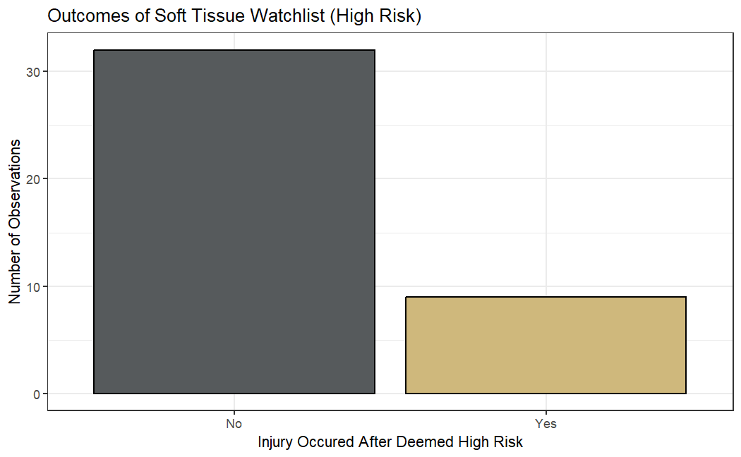
High Risk Results
General Results
Of 41 high risk assessments, 9 had HSI occur afterwards
However, 19 of these tests were done on February 27, 2025, or later and the incident report only goes until April 22, 2025, so it is possible more injuries have occurred since.
Notes:
Establishing baselines
Doubled tests performed

Slide 4
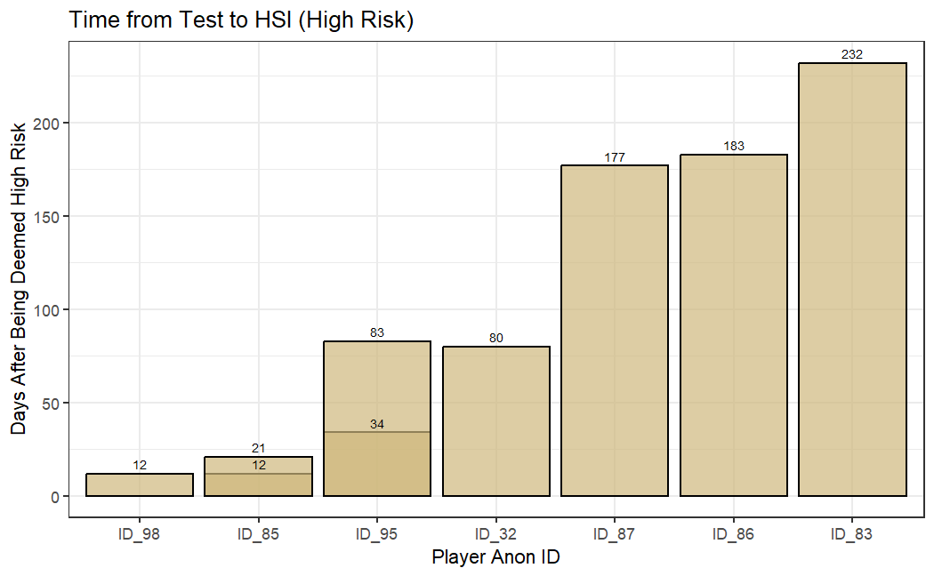
High Risk Results
Length of Time Analysis
7 unique players experienced HSI following being deemed high risk with ID_85 and ID_95 experiencing HSI twice after being deemed high risk
There are only 6 instances of HSI (including second instances) occurring within 90 days of the test and only 7 occurring within 180 days.
Notes:
Establishing baselines
Doubled tests performed

Slide 5
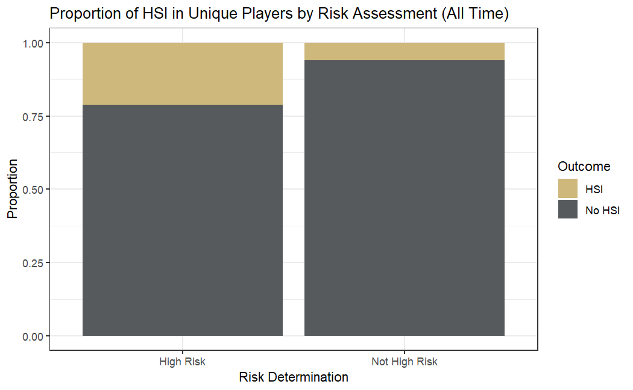
High Risk Results
Statistical Significance
7/33 players deemed high risk experienced HSI
14/235 players not deemed high risk experienced HSI
Fisher's Exact Test:
P-value: 0.007498
95% CI: (1.572198, Inf)
Notes:
Establishing baselines
Doubled tests performed

Slide 6
Question 2:
If so, how do the components of the watch list predict subsequent HSI injury risk?

Slide 7
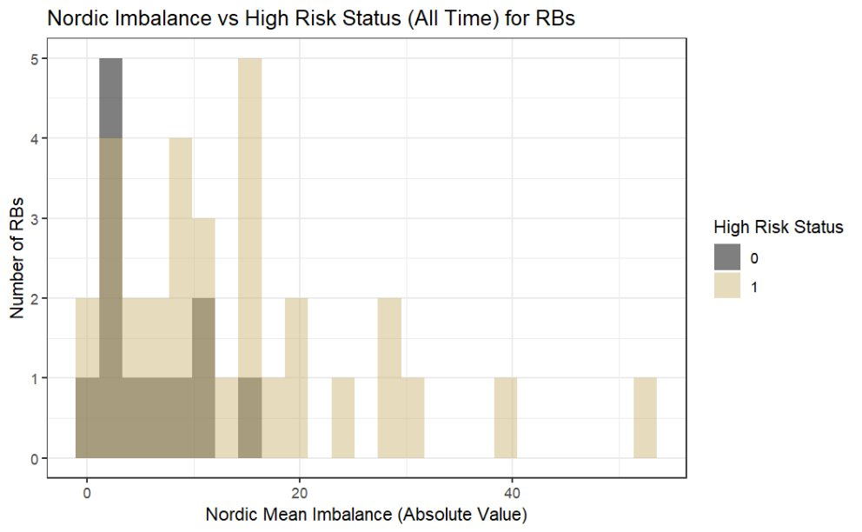
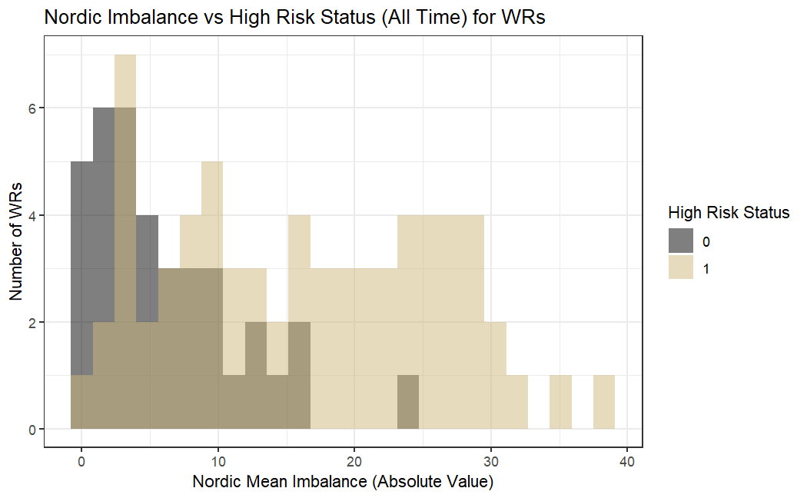
Nordic Mean Imbalance
Offensive Positions
P-value: 0.0007819 on 41.71 degrees of freedom
Mean High-risk: 13.9375
Mean Other: 5.4
P-value: 3.6e-10 on 103.5 degrees of freedom
Mean High-risk: 16.243478
Mean Other: 6.043243
Notes:
Establishing baselines
Doubled tests performed

Slide 8
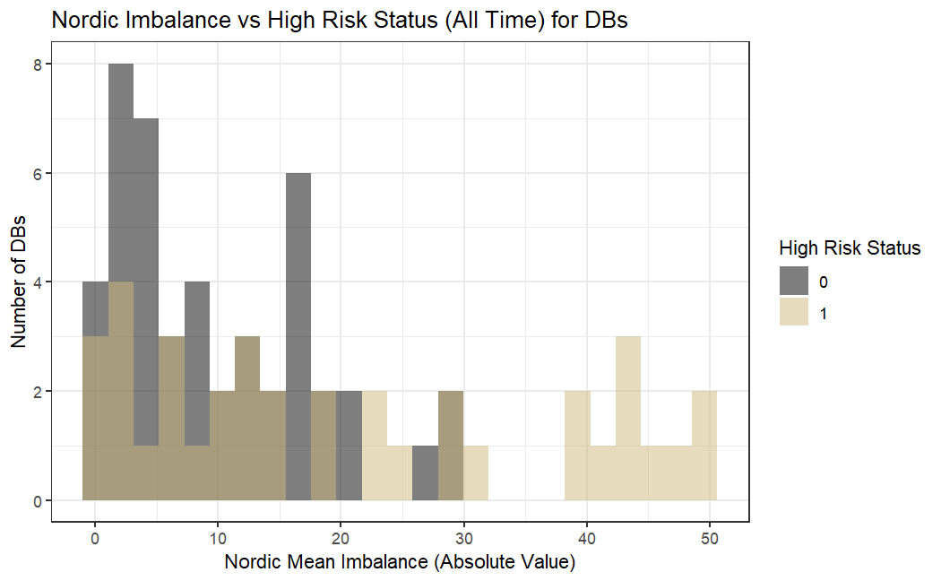
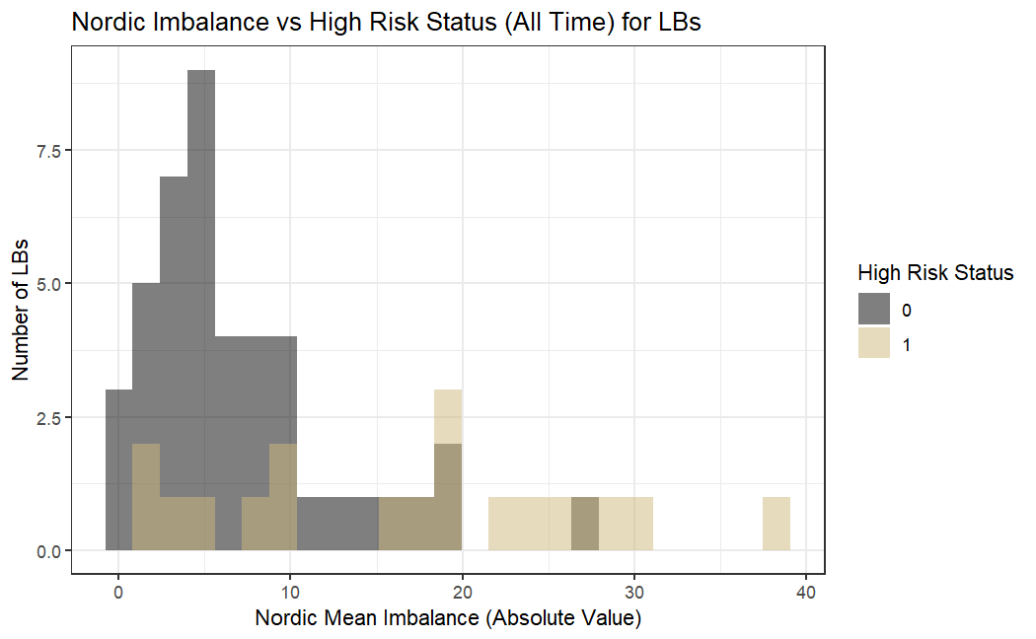
Nordic Mean Imbalance
Defensive Positions
P-value: 0.000365 on 49.394 degrees of freedom
Mean High-risk: 20.610811
Mean Other: 9.758696
P-value: 0.0003189 on 22.473 degrees of freedom
Mean High-risk: 17.136842
Mean Other: 6.834091
Notes:
Establishing baselines
Doubled tests performed

Slide 9
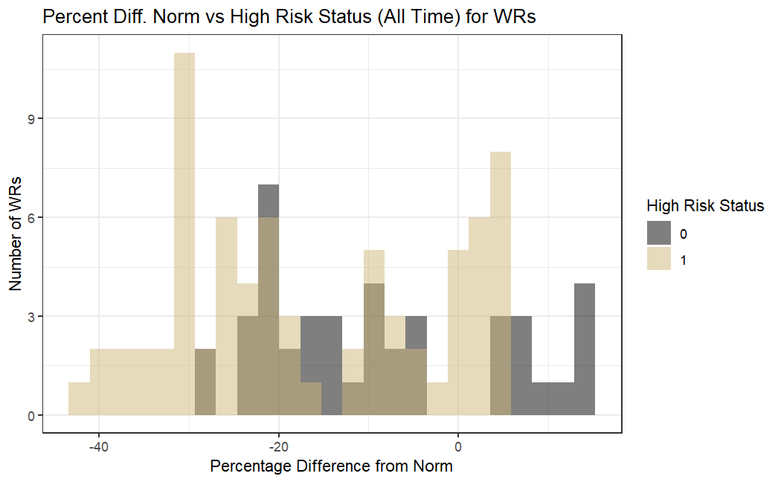
Percent Difference from Norm
Wide Receivers
P-value: 0.001789 on 92.665 degrees of freedom
Mean High-risk: -16.584169
Mean Other: -8.732488
Notes:
Establishing baselines
Doubled tests performed

Slide 10
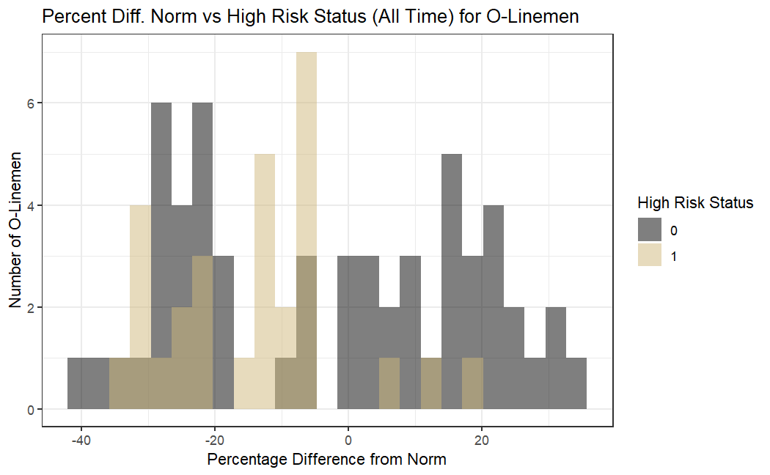
Percent Difference from Norm
Offensive Linemen
P-value: 0.002712 on 81.174 degrees of freedom
Mean High-risk: -13.791718
Mean Other: -3.147893
Notes:
Establishing baselines
Doubled tests performed

Slide 11
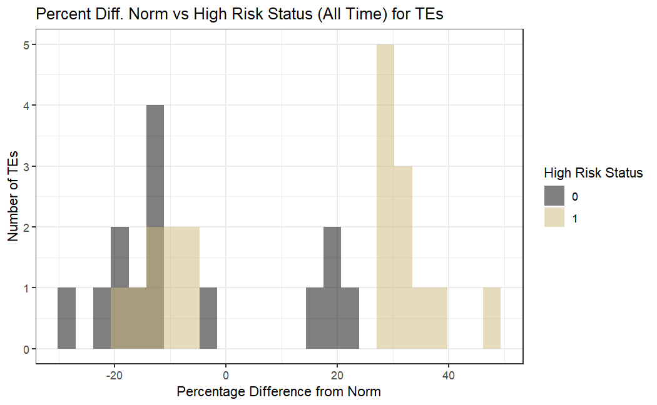
Percent Difference from Norm
Tight Ends
P-value: 0.003184 on 30.948 degrees of freedom
Mean High-risk: 14.110755
Mean Other: -6.273834
Notes:
Establishing baselines
Doubled tests performed

Slide 12
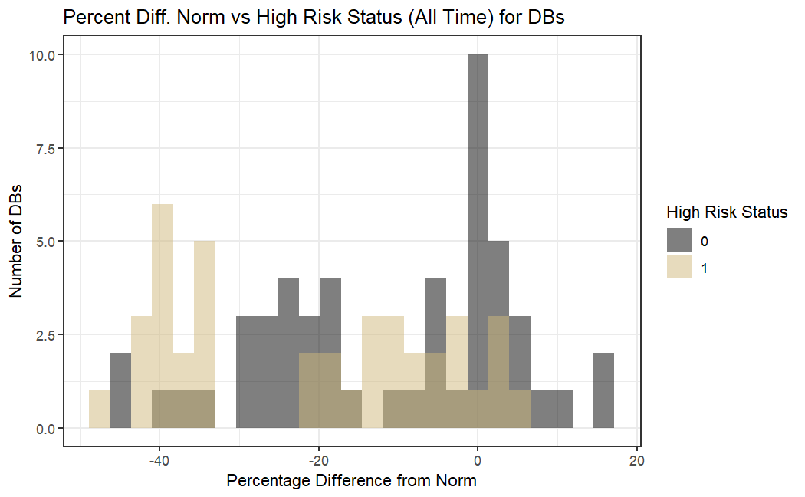
Percent Difference from Norm
Defensive Backs
P-value: 0.0025 on 81.574 degrees of freedom
Mean High-risk: -21.02827
Mean Other: -11.21050
Notes:
Establishing baselines
Doubled tests performed

Slide 13
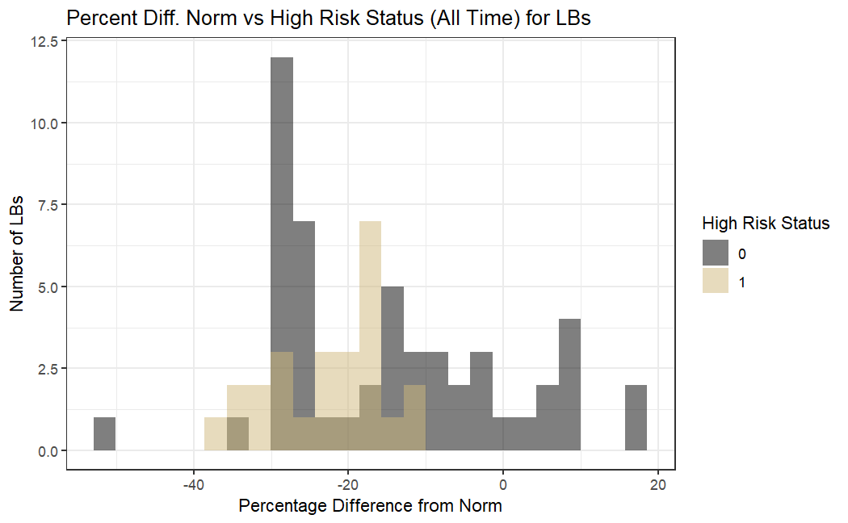
Percent Difference from Norm
Line Backers
P-value: 0.0007234 on 73.928 degrees of freedom
Mean High-risk: -23.01696
Mean Other: -14.64791
Notes:
Establishing baselines
Doubled tests performed

Slide 14
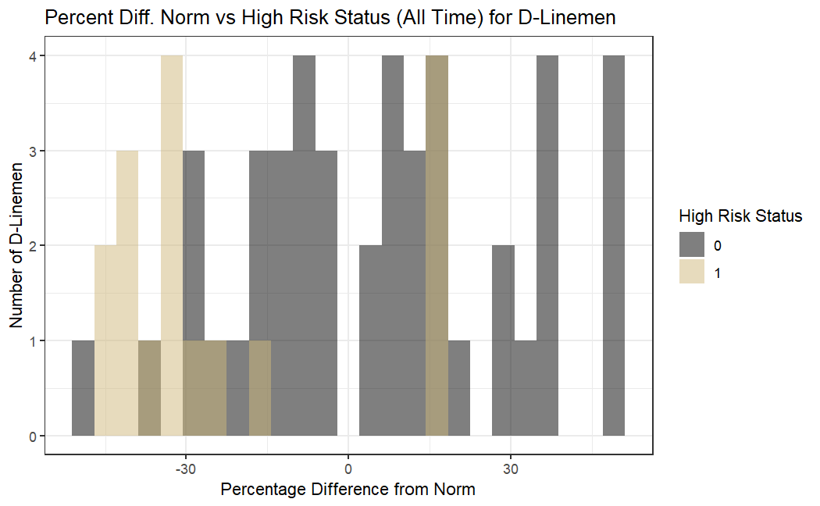
Percent Difference from Norm
Defensive Linemen
P-value: 0.0001241 on 29.894 degrees of freedom
Mean High-risk: -22.819469
Mean Other: 5.610945
Notes:
Establishing baselines
Doubled tests performed

Slide 15
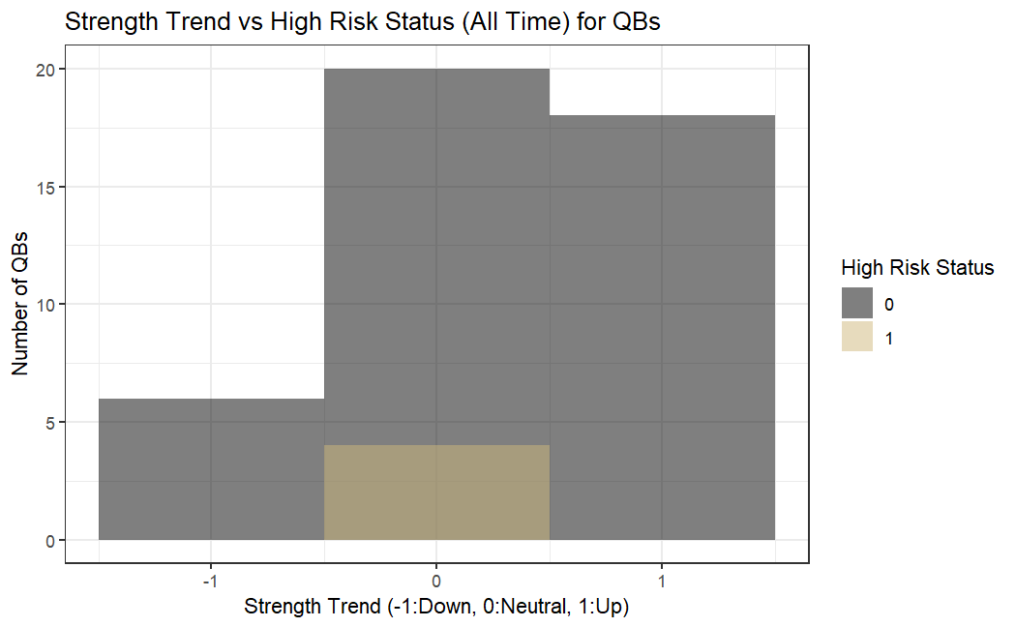
Strength Trend
Quarter Backs
P-value: 0.006273 on 43 degrees of freedom
Mean High-risk: 0
Mean Other: 0.2727273
There were not very many observations for high-risk quarterbacks
*
Notes:
Establishing baselines
Doubled tests performed

Slide 16
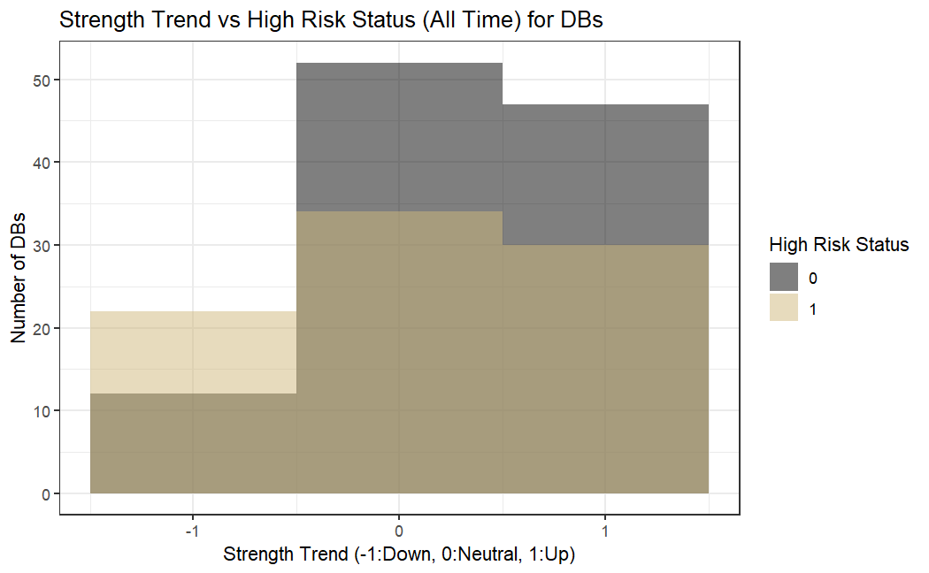
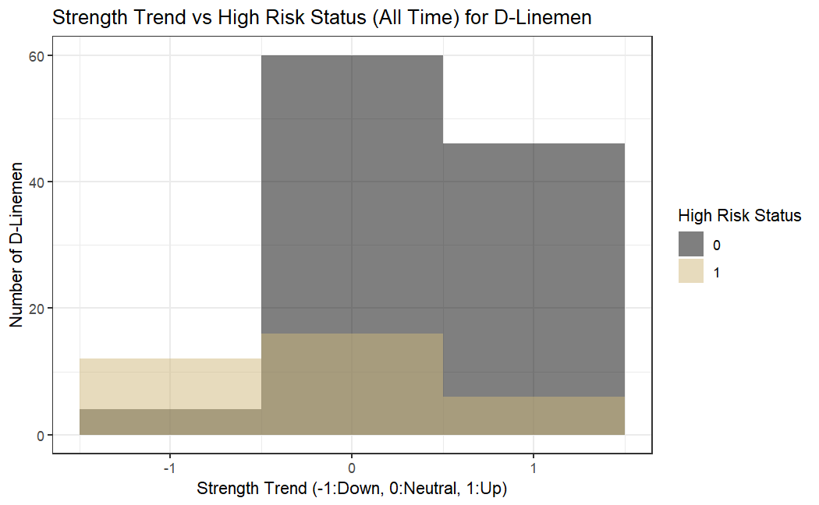
Strength Trend
Defensive Positions
P-value: 0.01752 on 166.53 degrees of freedom
Mean High-risk: 0.09302326
Mean Other: 0.31531532
P-value: 6.674e-05 on 46.053 degrees of freedom
Mean High-risk: -0.1764706
Mean Other: 0.3818182
*
Notes:
Establishing baselines
Doubled tests performed

Slide 17
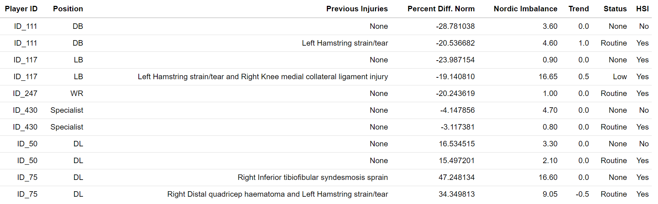
False Negatives
Player ID_111, player ID_117, and player ID_75 all had previous HSI before being deemed Routine or Low risk status, 20 of 58 total HSI can after another hamstring injury
Nordic mean imbalance can be positively or negatively impacted by previous leg injuries
Notes:
Establishing baselines
Doubled tests performed

Slide 18
Question 3:
If the components of the watch list are predictive of HSI, can we establish better thresholds as being flagged?

Slide 19
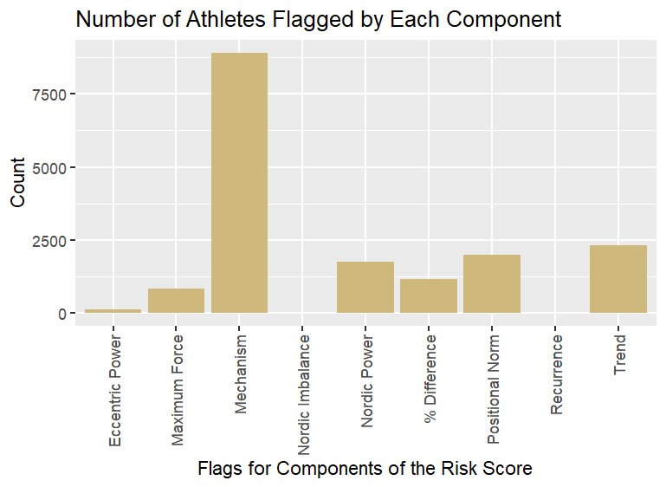
Components Importance in Risk Score
Old Components: previous injury, positional norm, imbalance, trend
New components: mechanism, Nordic power, percent difference, maximum force, and eccentric power
As we can see, more components can be a valuable addition to the watchlist to have a more accurate risk status, hopefully leading to better HSI prediction.
Notes:
To establish better thresholds to be flagged, we decided to add other components in to the computation of risk status to see how that would impact the thresholds of the components. Based off our research these are the components that would be most beneficial to utilize along with the components already used in the watch list. Thresholds for each component were made in reference to each different position as position plays a crucial role in the risk status as well. We found thresholds at the 10, 25, 50, and 75% marks. Then we created a new risk status list that is a score ranging from 0-6. Where the risk score encompasses all of the previous components together while taking into account the thresholds made.

Slide 20
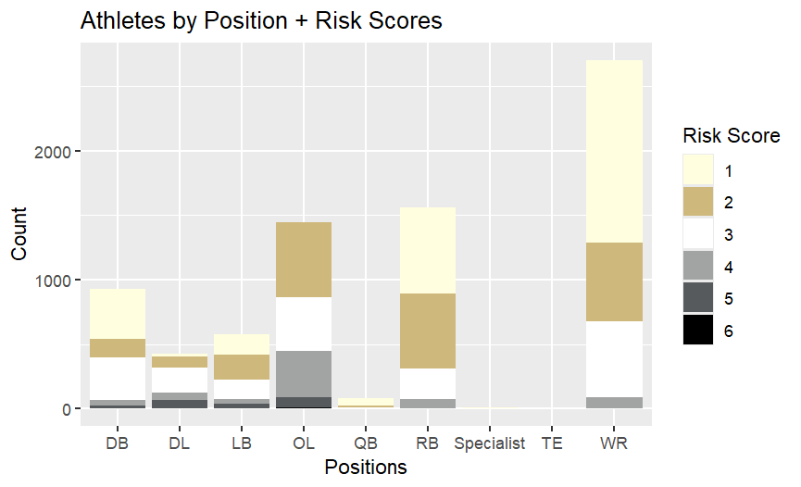
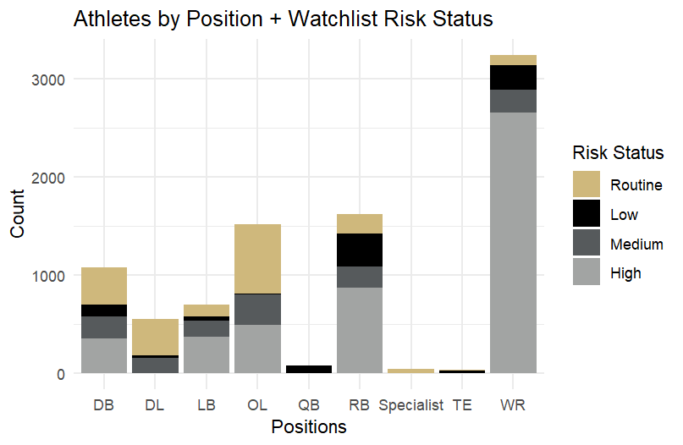
New vs Old Risk Measurements
Notes:
The first graphic displays the variation of different risk scores by position. This is the new risk score computed through the combination of components from the previous slide. As you can see the majority of the scores are between 1 and 3. With a score between 4 and 6 being considered high risk. Offensive line have the greastest amount of high risk athletes.
The second graphic shows the variation in different risk status' from the watchlist to compare to the new risk status scores. It does appear to be quite a bit different then the risk scores. As high risk is lead by wide receiver's, followed by running backs, and then the offensive line.

Slide 21
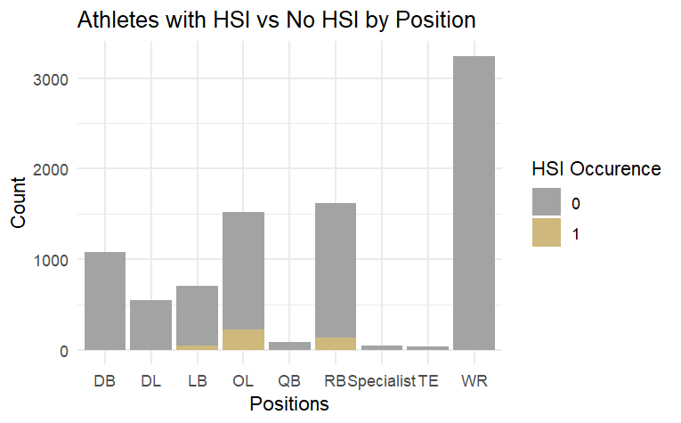
Positions by Actual HSI Event
Notes:
Lastly, we will compare actual SI incident to the risk score and watchlist risk status.
Going back and forth we can see that the positions with an HIS occurrence, (offensive line, running back, then, line back). Line up with the risk score numbers of 4 and 5 . Which is considered high risk almost identically. While the watchlist risk status is very off as it was quite different from the risk scores as well.

Slide 22
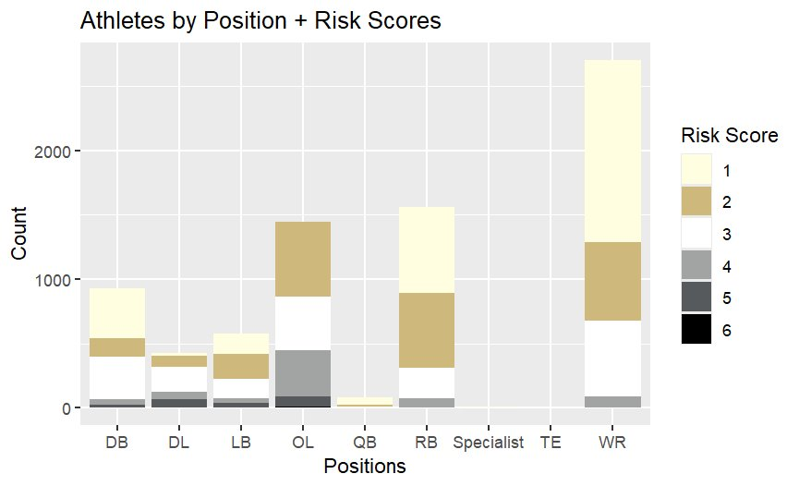
Positions by Actual HSI Event
Notes:
Just to compare to actual HSI occurrence.

Slide 23
Concluding Thoughts
Question 1: There is a statistically significantly greater proportion of HSI that occurs in those that are high risk vs those that weren't so while this risk determination doesn't just simply predict HSI incidence it is a significant metric
Question 2: The components of the watchlist's ability to predict subsequent injury risk depends on the football position but for most there is also a statistically significant difference in the average values of these components between high-risk athletes and non-high-risk athletes
Question 3: The components of the watchlist are predictive of HSI, but adding components such as eccentric power, a maximum average force z-score, nordic power z-score, mechanism of injury, and recurrence of injury all contribute to predictability power of HSI through creating risk score factor.

Slide 24
Further Thoughts

